Slide 1
BIRCH: Balanced Iterative Reducing and Clustering Using Hierarchies
A hierarchical clustering method.
It introduces two concepts :
Clustering feature
Clustering feature tree (CF tree)
These structures help the clustering method achieve good speed and scalability in large databases.

Slide 2
Motivation
Major weakness of agglomerative clustering methods
  Do not scale well; time complexity of at least O(n²), where n is total number of objects
  Can never undo what was done previously
Birch: Balanced Iterative Reducing and Clustering using Hierarchies
  Incrementally construct a CF (Clustering Feature) tree, a hierarchical data structure summarizing cluster info; finds a good clustering with a single scan
  Apply multi-phase clustering; improves quality with a few additional scans

Slide 3
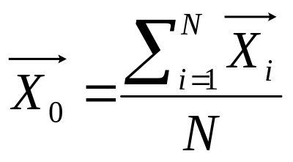
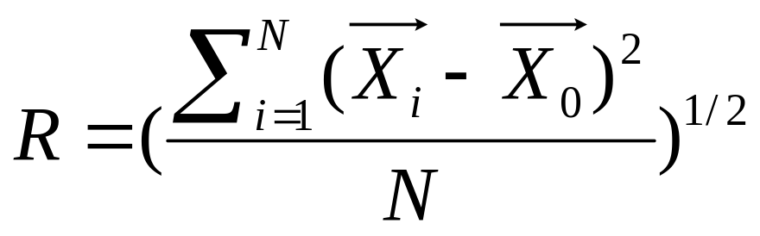
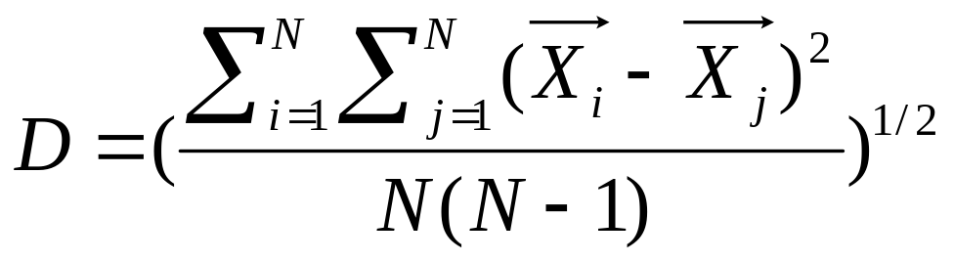
Summarized Info for Single cluster
Given a cluster with N objects
    Centroid
    Radius
    Diameter

Slide 4
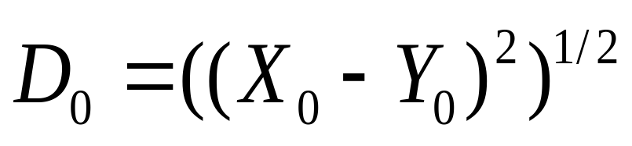
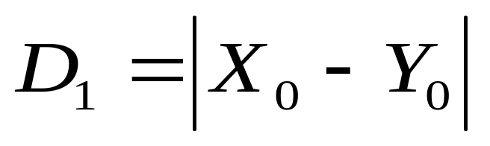
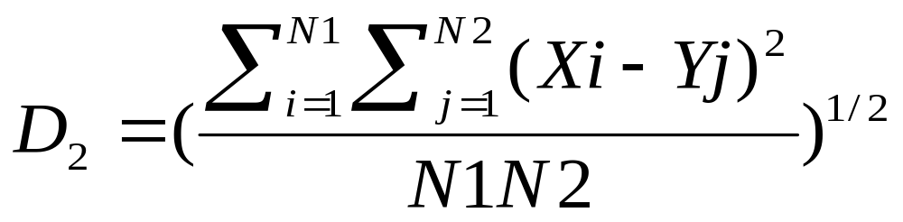
Summarized Info for Two Clusters
Given two clusters with N1 and N2 objects, respectively
  Centroid Euclidean distance
  Centroid Manhattan distance
  Average inter-cluster distance

Slide 5
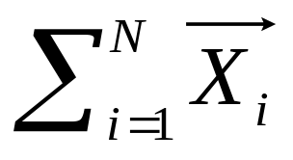
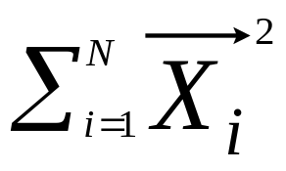
Clustering Feature (CF)
CF = (N, LS, SS)
  N =|C|
    Number of data points
  LS = (V_{i1}, …V_{id}) = O_{i}
N N N N
LS = ∑ Oi = (∑Vi1, ∑ Vi2,… ∑Vid)
i=1 i=1 i=1 i =1
    Linear sum of N data points
  SS =
    square sum of N data points

Slide 6

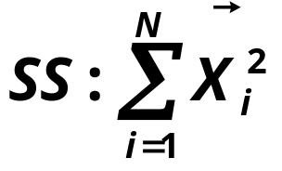
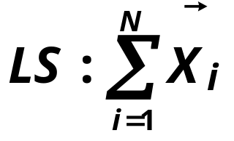
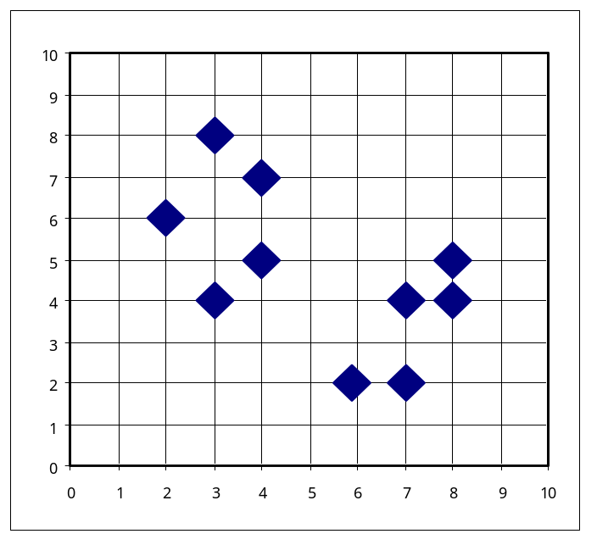
Example of Clustering Feature Vector
Clustering Feature:
N: Number of data points
CF = (5, (16, 30), (54, 190))
(3,4)
(2,6)
(4,5)
(4,7)
(3,8)

Slide 7
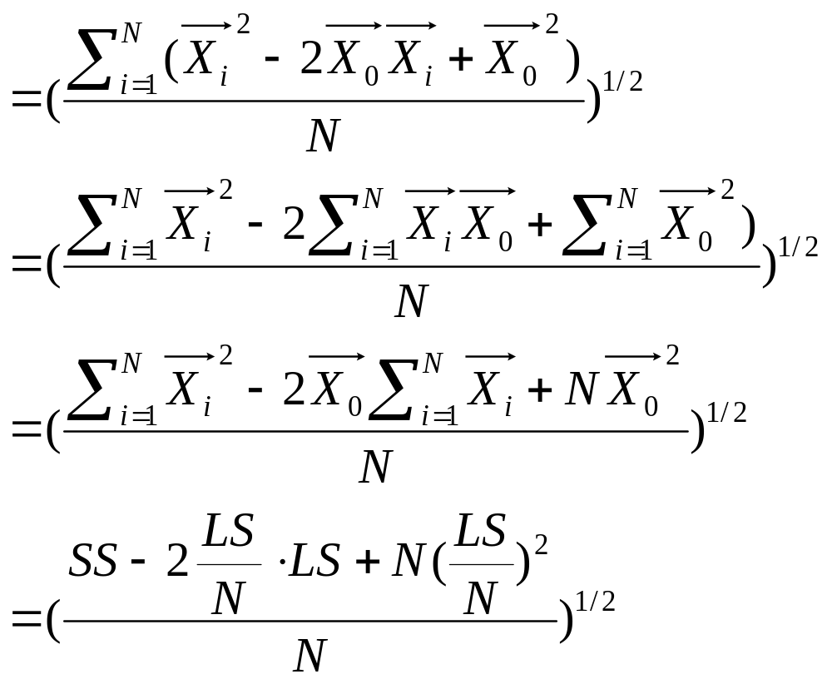

Slide 8
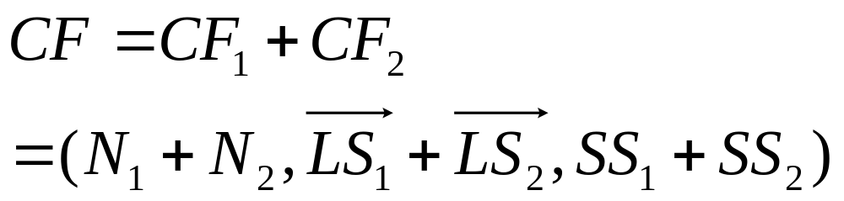
CF Additive Theorem
Suppose cluster C₁ has CF₁=(N₁, LS₁ ,SS₁), cluster C₂ has CF₂ =(N₂,LS₂,SS₂)
If we merge C₁ with C₂, the CF for the merged cluster C is
Why CF?
    Summarized info for single cluster
    Summarized info for two clusters
    Additive theorem

Slide 9
Example of Clustering Feature Vector
Clustering Feature:
N: Number of data points
CF₁ = (5, (16, 30), (54, 190))
CF₂ = (5, (36, 17), (262, 61))
(3,4)
(2,6)
(4,5)
(4,7)
(3,8)
(6,2)
(7,2)
(7,4)
(8,4)
(8,5)
CF = (10, (52, 47), (316, 251))

Slide 10
Clustering Feature Tree (CFT)
Clustering feature tree (CFT) is an alternative representation of data set:
  Each non-leaf node is a cluster comprising sub-clusters corresponding to entries (at most B) in non-leaf node
  Each leaf node is a cluster comprising sub-clusters corresponding to entries (at most L) in leaf node and each sub-cluster’s diameter is at most T; when T is larger, CFT is smaller
  Each node must fit a memory page

Slide 11
Example of CF Tree
Root
B = 7
L = 6
CF₁
CF₂
CF₃
CF₆
child₁
child₂
child₃
child₆
Non-leaf node
CF₉
CF₁₀
CF₁₁
CF₁₃
child₁
child₂
child₃
child₅
Leaf node
Leaf node
prev
CF₉₀
CF₉₁
CF₉₄
next
prev
CF₉₅
CF₉₆
CF₉₈
next

Slide 12
BIRCH Phase 1
Phase 1 scans data points and build in-memory CFT;
Start from root, traverse down tree to choose closest leaf node for d
Search for closest entry L_{i} in leaf node
If d can be inserted in L_{i}, then update CF vector of L_{i}
Else if node has space to insert new entry, insert; else split node
Once inserted, update nodes along path to the root; if there is splitting, need to insert new entry in parent node (which may result in further splitting)

Slide 13

Example of the BIRCH Algorithm
sc8
sc3
sc1
sc4
sc7
sc5
sc6
sc2
LN2
LN3
Root
LN1
LN2
LN3
LN1
sc8
sc3
sc5
sc6
sc7
sc1
sc2
sc4

Slide 14
Merge Operation in BIRCH
If the branching factor of a leaf node can not exceed 3
, then LN1 is split.
sc8
sc3
sc1
sc4
sc7
sc5
sc6
sc2
LN1’
LN2
LN3
Root
LN1”
LN1’
LN2
LN3
LN1”
sc8
sc3
sc5
sc6
sc7
sc1
sc2
sc4

Slide 15
Merge Operation in BIRCH
If the branching factor of a non-leaf node can not
exceed 3, then the root is split and the height of
the CF Tree increases by one.
sc8
sc3
sc1
sc4
sc7
sc5
sc6
sc2
LN1’
LN2
LN3
LN1”
Root
NLN1
NLN2
LN1’
LN1”
LN2
LN3
sc8
sc2
sc3
sc5
sc6
sc7
sc1
sc4

Slide 16
Merge Operation in BIRCH
Assume that the subclusters are numbered according to
the order of formation.
sc5
sc2
sc6
sc3
sc4
sc1
root
LN1
LN2
LN2
LN1
sc6
sc1
sc2
sc3
sc4
sc5

Slide 17
If the branching factor of a leaf node can not exceed 3,
Then LN2 is split.
sc5
sc2
sc6
sc3
sc4
sc1
LN1
LN2”
root
LN2’
LN2’
LN2”
LN1
sc6
sc1
sc2
sc5
sc4
sc3

Slide 18
LN2’ and LN1 will be merged, and the newly formed
Node will be split immediately.
sc5
sc2
sc6
sc3
sc4
sc1
LN3’
LN2”
root
LN3”
LN3’
LN3”
LN2”
sc6
sc2
sc1
sc5
sc4
sc3

Slide 19
Cases that Troubles BIRCH
The objects are numbered by the incoming order and assume that the distance between objects 1 and 2 exceeds the diameter threshold.
6
15
5
7
8
1
11
3
4
2
14
9
10
12
Subcluster 1
13
Subcluster 2

Slide 20
Order Dependence
Incremental clustering algorithm such as BIRCH suffers order dependence.
As the previous example demonstrates, the split and merge operations can alleviate order dependence to certain extent.
In the example that demonstrates the merge operation, the split and merge operations together improve clustering quality.
However, order dependence can not be completely avoided. If no new objects were added to form subcluster 6, then the clustering quality is not satisfactory.

Slide 21
Several Issues with the CF Tree
No of entries in CFT node limited by page size; thus, node may not correspond to natural cluster
  Two sub-clusters that should be in one cluster are splitted across nodes
  Two sub-clusters that should not be in one cluster are kept in same node (dependent on input order and skewness)
Sensitive to skewed input order
  Data point may end in leaf node where it should not have been
  If data point is inserted twice at different times, may end up in two copies at two distinct leaf nodes

Slide 22
BIRCH Phases X
Phase: Global clustering
  Use existing clustering (e.g., AGNES) algorithm on sub-clusters at leaf nodes
  May treat each sub-cluster as a point (its centroid) and perform clustering on these points
  Clusters produced closer to data distribution pattern
Phase: Cluster refinement
  Redistribute (re-label) all data points w.r.t. clusters produced by global clustering
  This phase may be repeated to improve cluster quality

Slide 23
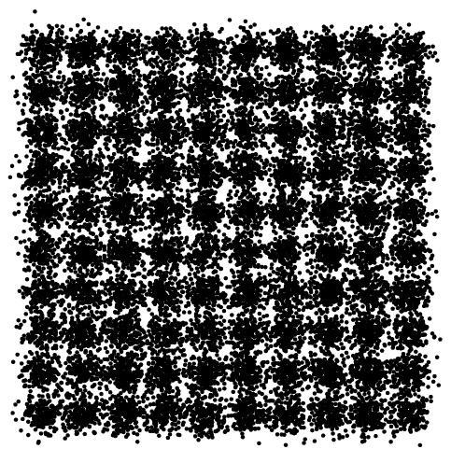
Data set
10 columns
clusters
10 rows

Slide 24
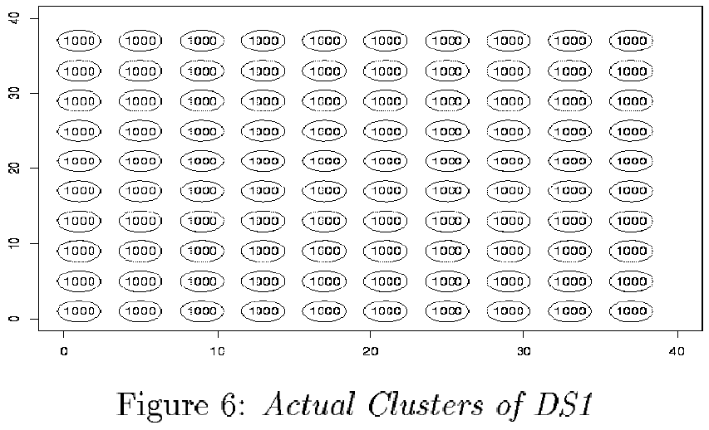
BIRCH and CLARANS comparison

Slide 25
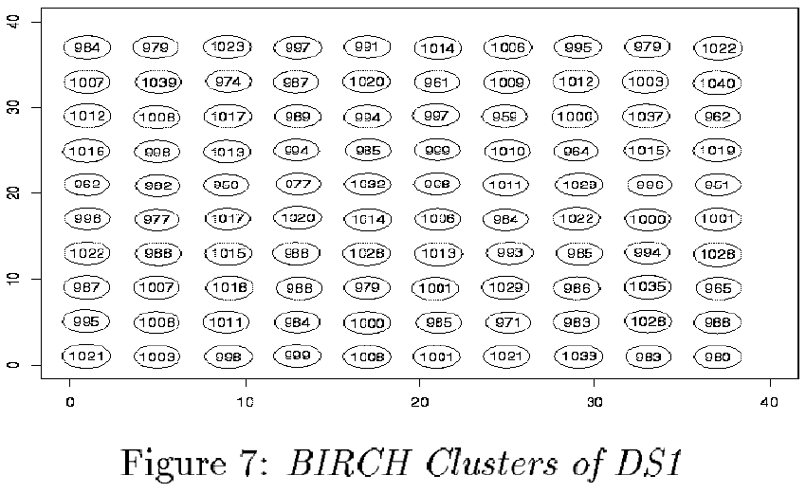
BIRCH and CLARANS comparison

Slide 26
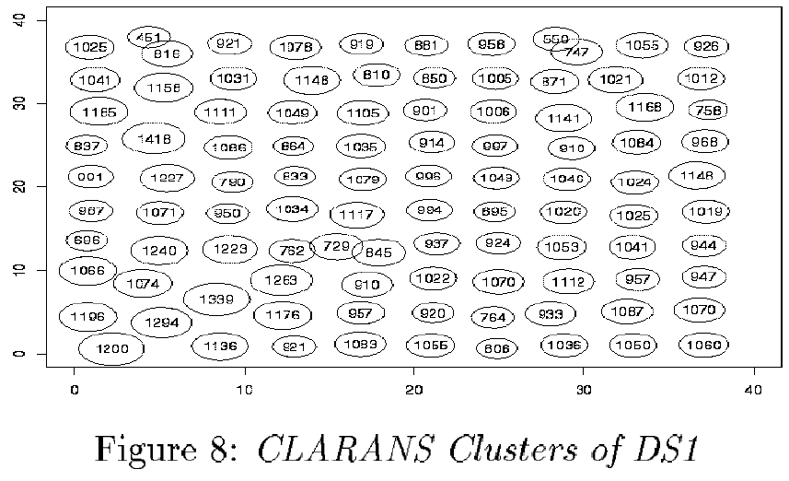
BIRCH and CLARANS comparison

Slide 27
BIRCH and CLARANS comparison
Result visualization:
  Cluster represented as a circle
  Circle center is centroid; circle radius is cluster radius
  Number of points in cluster labeled in circle
BIRCH results:
  BIRCH clusters are similar to actual clusters
  Maximal and average difference between centroids of actual and corresponding BIRCH cluster are 0.17 and 0.07 respectively
  No of points in BIRCH cluster is no more than 4% different from that of corresponding actual cluster
  Radii of BIRCH clusters are close to those of actual clusters

Slide 28
CLARANS results:
  Pattern of location of cluster centers distorted
  No of data points in a cluster as much as 57% different from that of actual cluster
  Radii of cluster vary from 1.15 to 1.94 w.r.t. avg of 1.44

Slide 29
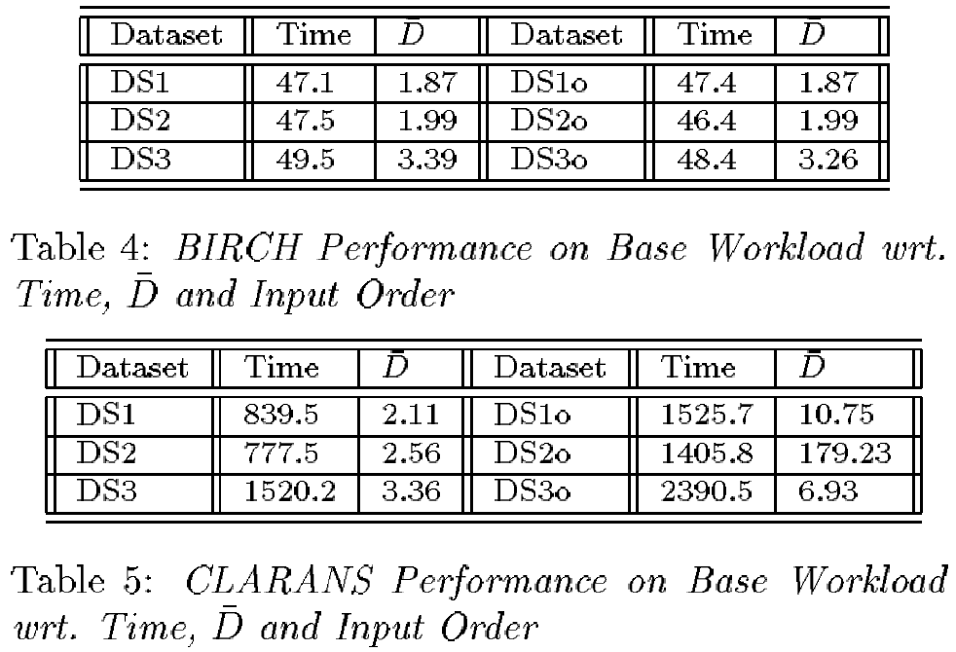
  BIRCH performance on Base Workload w.r.t. Time, data set and input order
  BIRCH performance on Base Workload w.r.t. Time, diameter and input order
  CLARANS performance on Base Workload w.r.t. Time, data set and input order
  CLARANS performance on Base Workload w.r.t. Time, diameter and input order

Slide 30
BIRCH and CLARANS comparison
Parameters:
  D: average diameter; smaller means better cluster quality
  Time: time to cluster datasets (in seconds)
  Order (‘o’): points in the same cluster are placed together in the input data
Results:
  BIRCH took less than 50 secs to cluster 100,000 data points of each dataset (on an HP 9000 workstation with 80K memory)
  Ordering of data points also have no impact
  CLARANS is at least 15 times slower than BIRCH; when data points are ordered, CLARANS performance degrades

